Slide 1
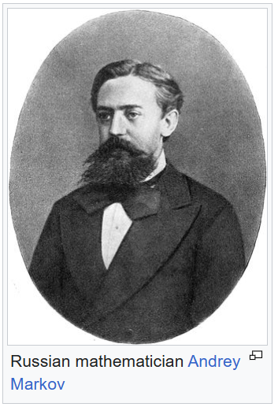

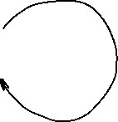

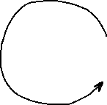
Hidden Markov Models
Imagine that we cannot observe/measure the states directly, but the states emit data
The goal is to determine the most likely sequence of states given the model and the observed data
0.8
0.2
0.8
0.2

Slide 2

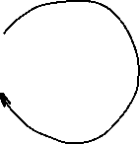

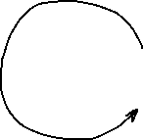
Hidden Markov Models
A Hidden Markov Model is a Markov model that emits data at each state with different probability distributions, and transition probabilities are known (or can be estimated)
Blue state emits data distributed according to probabilities P_{b} and Green state emits data distributed with probabilities P_{g}
0.8
0.2
0.8
0.2

Slide 3
The game
Imagine the following game:
  One coin is fair: probability of heads or tails is 50%
  One coin is biased: probability of heads is 90%
  Coins look identical to us (state cannot be observed directly)
The game (repeats N times):
  Dealer picks a coin with probability 50% in secret, flips it and makes the result visible
  Dealer then switches the coin with probability 20% in secret
Our goal is to guess which coin is used at every toss
0.8
0.2
0.8
Fair (F)
Bias (B)
0.2

Slide 4
Hidden Markov Models
A walk in HMM from the dealer’s perspective:
FFBB
HTHH
We observe:
HTHH
0.8
0.2
0.8
Fair (F)
Bias (B)
0.2

Slide 5
Hidden Markov Models
A walk in HMM from the dealer’s perspective:
FFBB
HTHH
It is easy for the dealer to compute the probability:
Pr(FFBB)=Pr(start in F)*Pr(emit H in F)*Pr(stay in F)* Pr(emit T in F)* Pr(switch to B)* Pr(emit H in B)*Pr(stay in B)* Pr(emit H in B) =
0.5*0.5*0.8*0.5*0.2*0.9*0.8*0.9
0.8
0.2
0.8
Fair (F)
Bias (B)
0.2

Slide 6
Hidden Markov Models
A walk in HMM from the dealer’s perspective:
FFBB
HTHH
What can we do? The coins are hidden from us!
Try all possible sequences of 4-letter combinations of F and B, compute probabilities (2^4)
0.8
0.2
0.8
Fair (F)
Bias (B)
0.2

Slide 7
Hidden Markov Models
F
B
F
B
F
B
2^4=16 probabilities,
Pick the guess with the highest probability
Not feasible to do for long runs!!!
F
B
F
B
F
B
F
B
F
B
F
B
F
B
F
B
F
B
F
B
F
B
F
B
0.8
0.2
0.8
Fair (F)
Bias (B)
0.2

Slide 8
Hidden Markov Models
Use Viterbi algorithm for long runs
  Input: HMM and the sequence: HHTH…
  Output: a state sequence with maximum probability: FFBB…
0.8
0.2
0.8
Fair (F)
Bias (B)
0.2

Slide 9
Gene finding with HMMs
We know the sequence of a genome, how can we find where the coding sequences are?
AGAATGGATAGATAGGATAATAATGGGAAATTGATTTAAATTTA --?
The coding/noncoding regions are hidden states (like the coins)
Patterns of letters within coding and noncoding sequences differ
We can use the RNA-seq data or a closely related genome to:
  compute patterns for coding/noncoding sequence -- these are our emission probabilities
  compute transition probabilities between coding/noncoding states

Slide 10
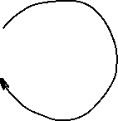

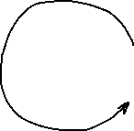
Gene finding with HMMs
Closely related annotated genome:
AGAATGGGTAGATAGGATCATAATGGCAAATTGATTTATATTTA
Assume a model:
44 letters, 2 coding->non-coding and 2 non-coding-> coding transitions
Train the model by computing emission probabilities:
  Coding: A:9/24, C:1/24, G:8/24, T:6/24
  Noncoding: A:8/20, C:1/20, G:2/20, T:9/20
Use Viterbi algorithm to figure out most likely sequence of states (N or C) given the model and emission probabilities; label the letters
21/22
1/22
21/22
Non-
coding
(N)
Coding
(C)
1/22

Slide 11
Viterbi algorithm for HMMs
Start
0.5
0.5
C
A 0.2
C 0.3
G 0.3
T 0.2
N
A 0.3
C 0.2
G 0.2
T 0.3
0.5
0.5
0.6
0.4
Let's consider the following simple HMM for coding/non-coding regions of DNA. This model is composed of 2 states, C (coding) and N (non-coding).

Slide 12
Viterbi algorithm for HMMs
Start
0.5
0.5
C
A 0.2
C 0.3
G 0.3
T 0.2
N
A 0.3
C 0.2
G 0.2
T 0.3
0.5
0.5
0.6
0.4
Consider the sequence S = GGCACTGAA
There are several paths through hidden states (C and N) that lead to this sequence, e.g. NNCCCCNNN
Prob(S) through this path is 0.5*0.2*0.6*0.2*0.4*0.3*...

Slide 13

Viterbi algorithm for HMMs
Start
0.5
0.5
C
A 0.2
C 0.3
G 0.3
T 0.2
N
A 0.3
C 0.2
G 0.2
T 0.3
0.5
0.5
0.6
0.4
Andrew James Viterbi
Image credit: Wikipedia
Consider the sequence S = GGCACTGAA
There are several paths through hidden states (C and N) that lead to this sequence, but they do not have the same probability
The Viterbi algorithm allows us to compute the most probable (best) path

Slide 14
Viterbi algorithm for HMMs
Start
Consider the sequence S = GGCACTGAA
The probability of the best
path ending in state l
with observation i is:
0.5
0.5
C
A 0.2
C 0.3
G 0.3
T 0.2
N
A 0.3
C 0.2
G 0.2
T 0.3
0.5
0.5
0.6
0.4
$$p_{l}\left(i,x\right)=e_{l}\left(i\right)\max_{k=(N,C)}{(}p_{k}\left(j,x−1\right)∗p_{kl})$$
Probability to observe element i in state l
Probability of the best path ending at position x-1 in state k with element j
Probability of transition from state k to state l

Slide 15
Viterbi algorithm for HMMs
Start
Consider the sequence S = GGCACTGAA
The probability of the best
path ending in state l
with observation i is:
In our example, the probability of the best path ending in state l=C with “A” at the 4th position is:
0.5
0.5
C
A 0.2
C 0.3
G 0.3
T 0.2
N
A 0.3
C 0.2
G 0.2
T 0.3
0.5
0.5
0.6
0.4
$$p_{l}\left(i,x\right)=e_{l}\left(i\right)\max_{k=(N,C)}{(}p_{k}\left(j,x−1\right)∗p_{kl})$$
$$p_{C}\left(A,4\right)=e_{C}\left(A\right)\max_{k}{(}p_{N}\left(C,3\right)∗p_{NC},p_{C}\left(C,3\right)∗p_{CC})$$

Slide 16
Viterbi algorithm for HMMs
For simplicity, let’s convert
everything to log₂(p):
Start
0.5
0.5
C
A 0.2
C 0.3
G 0.3
T 0.2
N
A 0.3
C 0.2
G 0.2
T 0.3
0.5
0.5
0.6
0.4

Slide 17
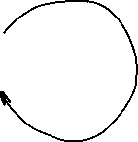
Viterbi algorithm for HMMs
For simplicity, let’s convert
everything to log₂(p):
This allows us to add
probabilities instead of
multiplying, which is
more efficient and accurate
Start
-1
-1
C
A -2.322
C -1.737
G -1.737
T -2.322
N
A -1.737
C -2.322
G -2.322
T -1.737
-1
-1
-0.737
-1.322

Slide 18
Viterbi algorithm for HMMs
Start
S = GGCACTGAA
Log probability that the first G
was emitted by state C:
Log probability that the first G
was emitted by state N:
-1
-1
C
A -2.322
C -1.737
G -1.737
T -2.322
N
A -1.737
C -2.322
G -2.322
T -1.737
-1
-1
-0.737
$$p_{C}\left(G,1\right)=−1−1.737=−2.737$$
-1.322
$$p_{N}\left(G,1\right)=−1−2.322=−3.322$$

Slide 19
Viterbi algorithm for HMMs
Start
S = GGCACTGAA
Log probability that the second G
was emitted by state C:
Log probability that the second G
was emitted by state N:
-1
-1
C
A -2.322
C -1.737
G -1.737
T -2.322
N
A -1.737
C -2.322
G -2.322
T -1.737
-1
-1
-0.737
-1.322
$$p_{C}\left(G,2\right)=−1.737+\max\left(p_{C}\left(G,1\right)+p_{CC},p_{N}\left(G,1\right)+p_{NC}\right)=−5.474$$
$$p_{N}\left(G,2\right)=−2.322+\max\left(p_{C}\left(G,1\right)+p_{CN},p_{N}\left(G,1\right)+p_{NN}\right)=−6.059$$

Slide 20
Viterbi algorithm for HMMs
Start
S = GGCACTGAA
Log probability that the second G
was emitted by state C:
Log probability that the second G
was emitted by state N:
-1
-1
C
A -2.322
C -1.737
G -1.737
T -2.322
N
A -1.737
C -2.322
G -2.322
T -1.737
-1
-1
-0.737
-1.322
$$p_{C}\left(G,2\right)=−1.737+\max\left(p_{C}\left(G,1\right)+p_{CC},p_{N}\left(G,1\right)+p_{NC}\right)=−5.474$$
-2.737-1
-3.322-1.322
$$p_{N}\left(G,2\right)=−2.322+\max\left(p_{C}\left(G,1\right)+p_{CN},p_{N}\left(G,1\right)+p_{NN}\right)=−6.059$$
-2.737-1
-3.322-0.737

Slide 21
Viterbi algorithm for HMMs
Start
S = GGCACTGAA
Log probability that the second G
was emitted by state C:
Log probability that the second G
was emitted by state N:
-1
-1
C
A -2.322
C -1.737
G -1.737
T -2.322
N
A -1.737
C -2.322
G -2.322
T -1.737
-1
-1
-0.737
-1.322
$$p_{C}\left(G,2\right)=−1.737+\max\left(p_{C}\left(G,1\right)+p_{CC},p_{N}\left(G,1\right)+p_{NC}\right)=−5.474$$
-2.737-1
-3.322-1.322
$$p_{N}\left(G,2\right)=−2.322+\max\left(p_{C}\left(G,1\right)+p_{CN},p_{N}\left(G,1\right)+p_{NN}\right)=−6.059$$
-2.737-1
-3.322-0.737

